Slide 1

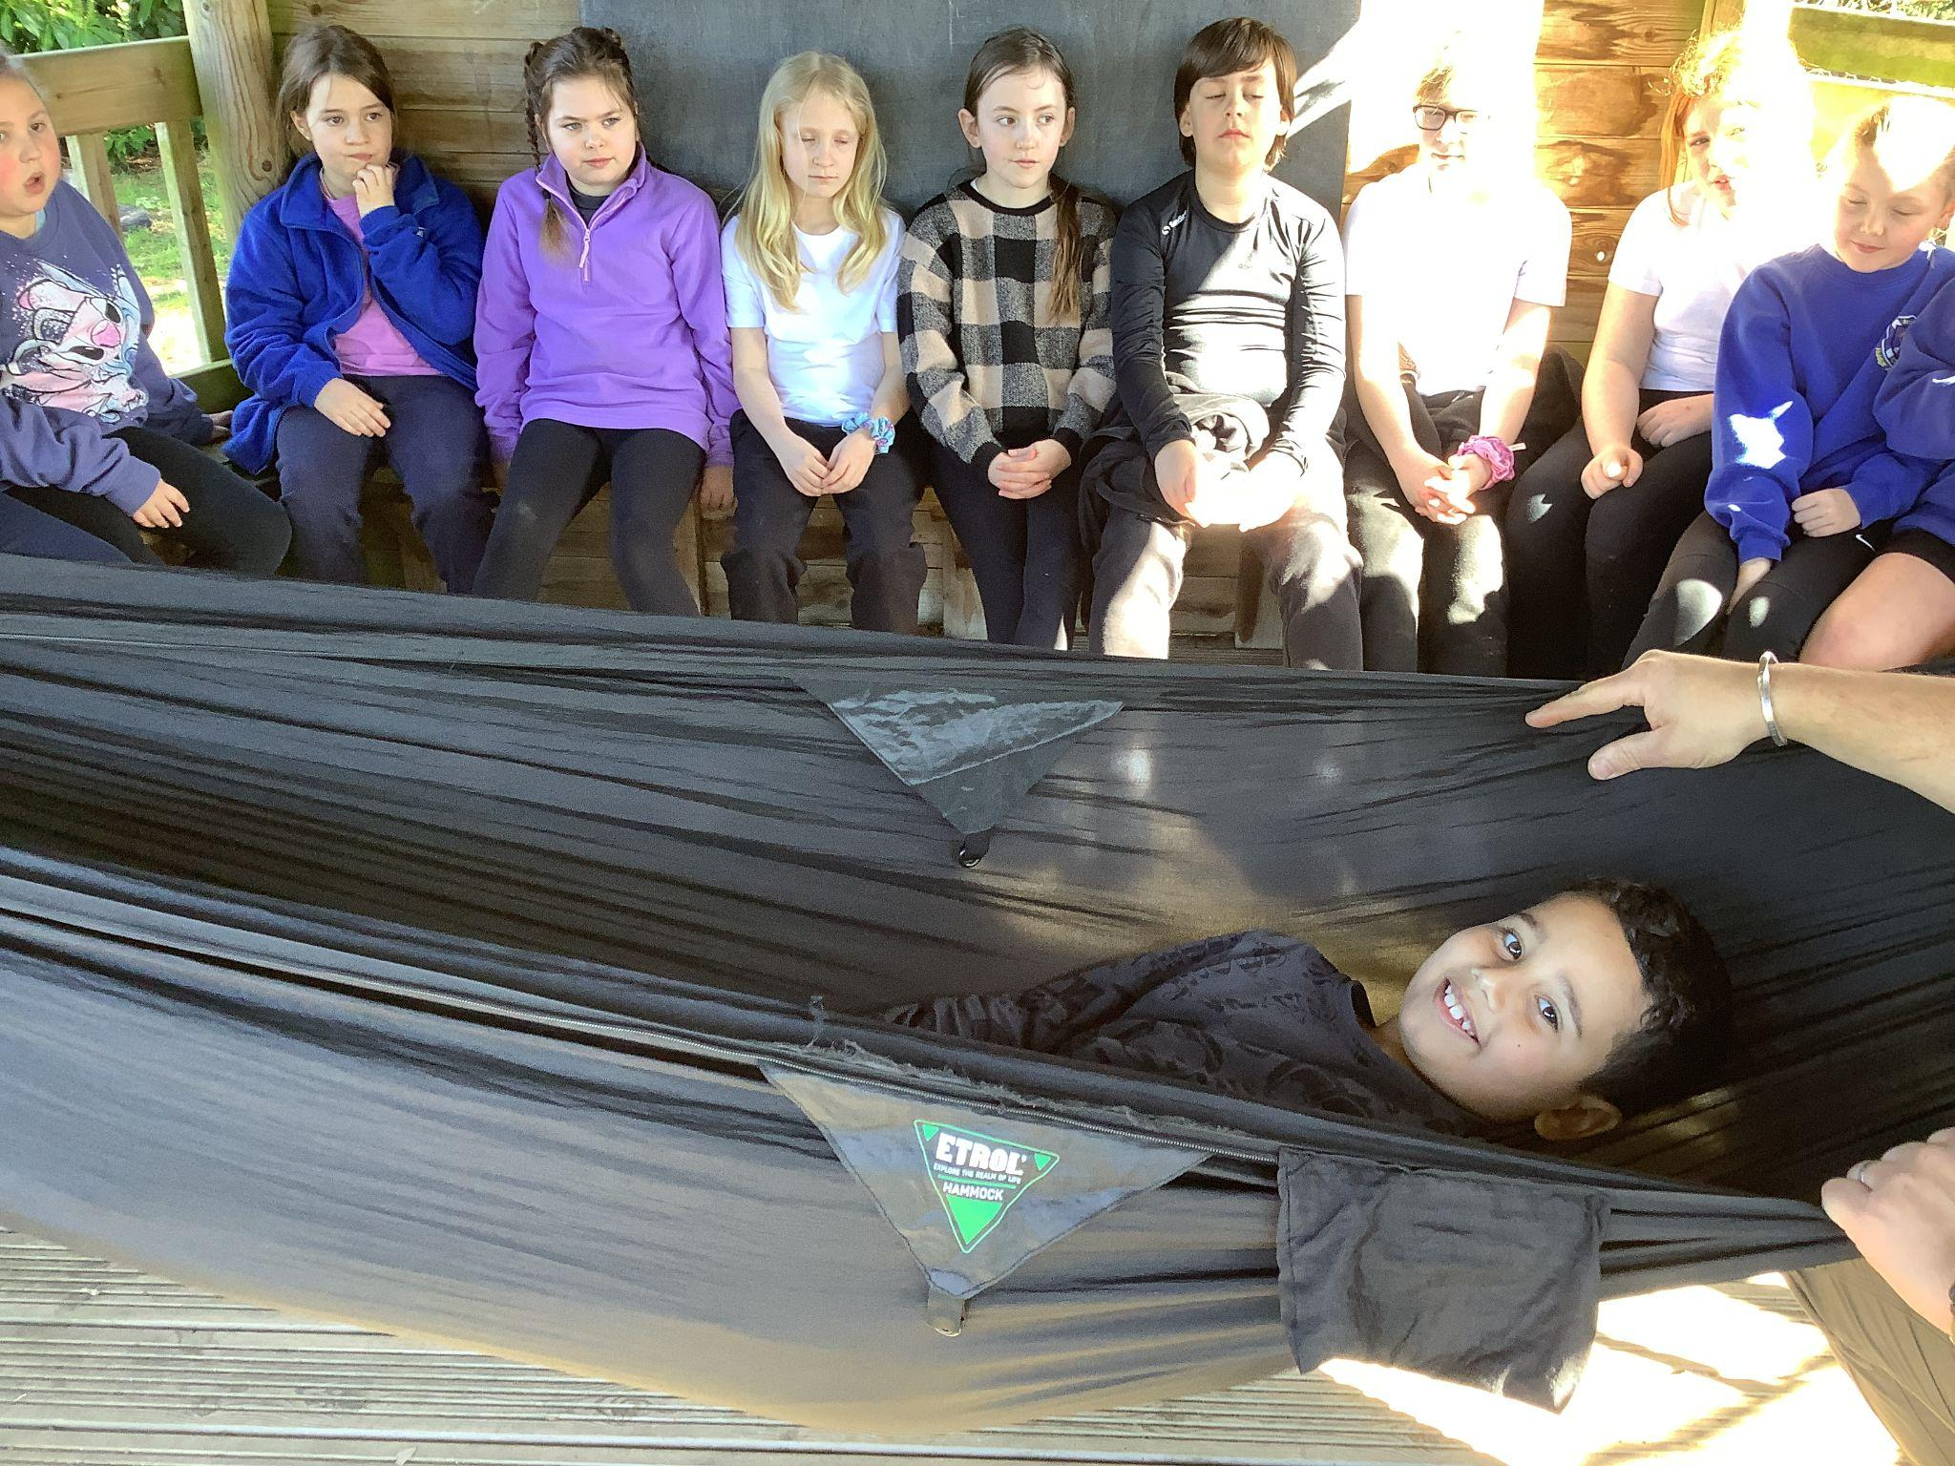
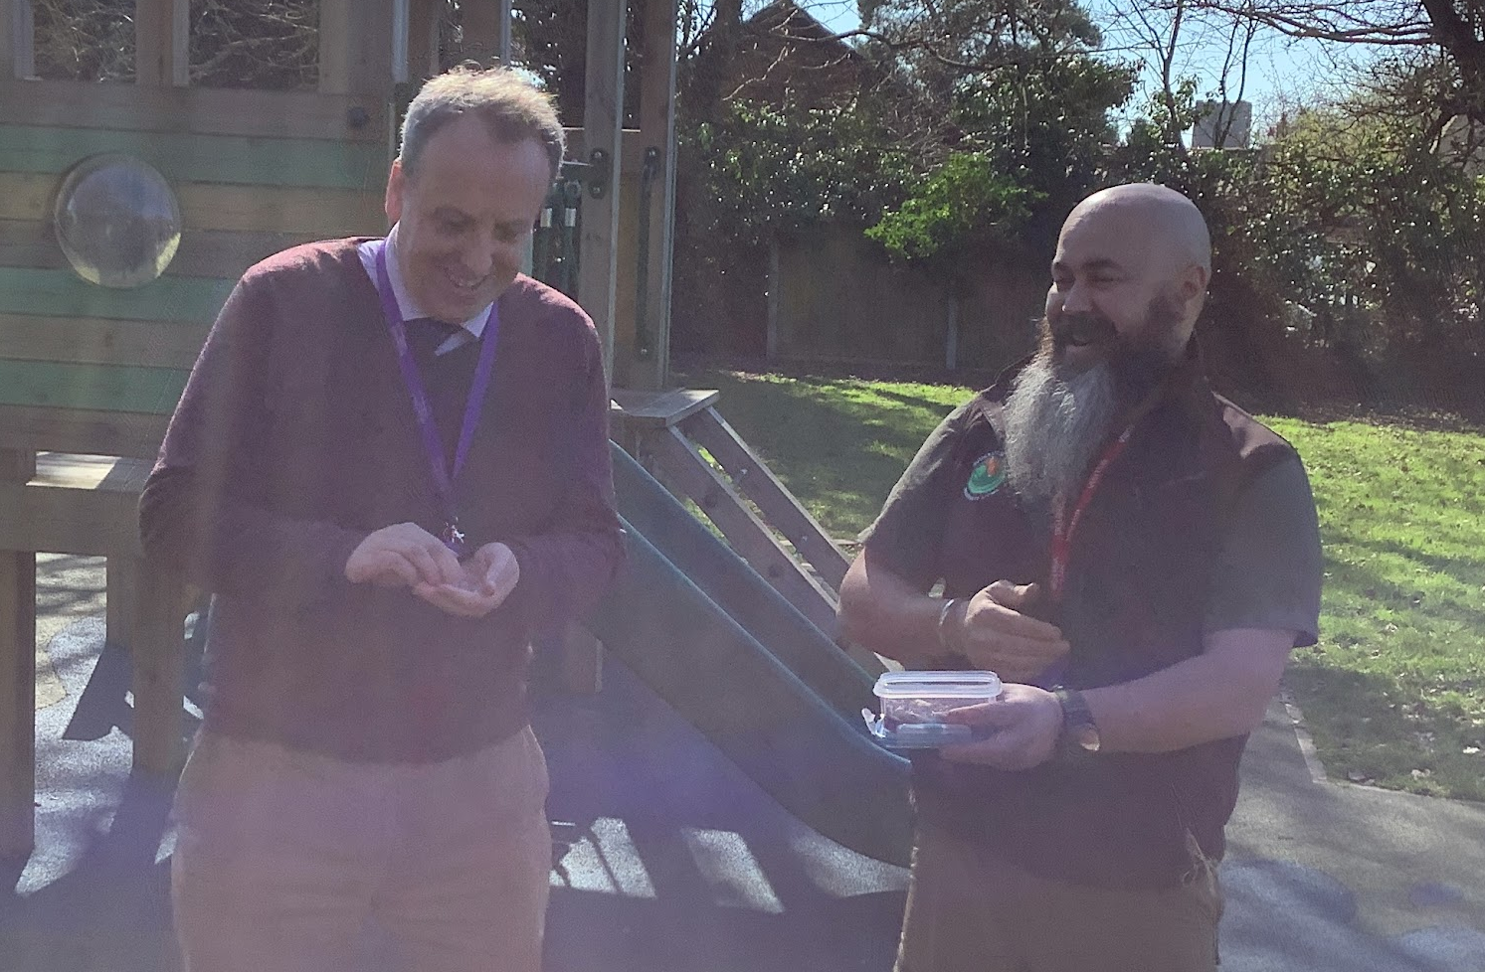
Scole Church of England Primary Academy
NEWSLETTER
20.3.26
Good afternoon,
Our KS2 children experienced an unforgettable Amazon Experience Day led by the fantastic Ray from Back to Wilderness!
From the moment the day began, pupils were fully immersed in life in the rainforest
Learning about the Amazon through videos and discussion
Exploring real survival equipment like hammocks, tarps and first aid kits
Discovering jungle tools (safely demonstrated!)
Watching fire-making techniques including flint & steel and bow drill
Even the chance for the brave to try edible insects!
The children were curious, engaged and incredibly enthusiastic throughout – asking brilliant questions and getting hands-on with real-life survival skills.
And a big thank you to FOSS for funding this amazing opportunity for our pupils – experiences like this make learning memorable and meaningful
Take a look at some highlights from the day below!
Have a wonderful weekend,
Mr B Aylmer
Senior Teacher
Scole Church of England Primary Academy
Amazon Experience
Our Improvement Director Mr P Seeman had a wonderful time getting involved eating some critters!
Facebook:
Scole C of E Primary
Instagram:
scole_c_of_e_primary_academy
Social Media

Slide 2
Awards
Cavell - Jeffery - For his fantastic hot write about a tarantula
Boudicca 3/4 - Martin - For always trying his best during times tables and showing lots of enthusiasm.
Boudicca 5/6 - Lola - For her hard work in mock SATs and fantastic progress being made.
Easter Service - Thursday 26th March
We will be going to St Andrews Church on Thursday 26th March at 9.15am, for our Easter Service, parents and carers are welcome to join us.
Oaklands Care Home
Residents of Oaklands Care Home, will be visiting our school on Friday 27th March at 10.45am and participate in various activities with our children for the morning.
New Spring / Summer Menu
New Spring / Summer Menu starts on Tuesday 14th April. Please see menu attached to Parentmail message.
Drumming performance
Over the last 10 weeks, Boudicca class have been learning how to play Samba Drums. We will be holding a special assembly for parents on Monday 23rd March at 2.50pm so the children can show you all their new skill.
Year 3/4 Swimming lessons starting 23rd April
We will be taking Years 3 and 4 for swimming lessons at Diss Leisure Centre, starting Thursday 23rd April continuing each week until, and including, Thursday 2nd July.
Celebration Assembly 27.3.26
Assembly will start slightly earlier, with the gate opening at 2:45 to allow Y5/6 to conduct a short dance performance. Parents welcome to attend
Road Closure
We have been advised Cadent Gas are closing the A1066 Diss / Victoria Road, between Sawmills Road (Easy Peasy Garage) and Dark Lane (Scole Roundabout) from the 7th April to 5th May - see https://one.network/uk/norfolk for more details, please look for an alternative route and allow extra travel time for drop off and pick up.
14th April - Return to School
Wednesday 15th - Friday 17th April - Year 3 and 4 Horstead Residential.

